Slide 1

MASTER PROJECT
MONEY LAUNDERING TRANSACTION DETECTION
USING MACHINE LEARNING ALGORITHMS
PRESENTED BY:
NUR ADRIANA BATRISYIA BINTI MOHD SUBRI (MCS241007)
SUPERVISOR: DR NOR HAIZAN BINTI MOHAMED RADZI

Slide 2
01
CONTENT OUTLINES
INTRODUCTION
02
LITERATURE REVIEW
03
RESEARCH METHODOLOGY
04
DATA PREPARATION
05
MODEL DEVELOPMENT AND EVALUATION
06
DASHBOARD DEVELOPMENT
07
CONCLUSION

Slide 3

CHAPTER 1
INTRODUCTION

Slide 4

MONEY LAUNDERING
A serious global issue since the 1980s. It is recognized as a threat to economic stability and security worldwide.
Linked to crimes like fraud, drug trafficking – to disguise the origin of illegal funds
Lead to higher crime rates, threaten national security risks, increase corruption
Financial institutions are under pressure to detect and prevent money laundering
Traditional AML systems are rule-based, requiring frequent updates and human review
As laundering techniques become more complex, traditional approach is no longer sufficient. Hence, the need to integrate machine learning into AML efforts.
Notes:
Money laundering is a serious global issue linked to crimes like fraud and drug trafficking, and with evolving techniques, traditional rule-based systems are no longer sufficient — creating a need for machine learning in AML efforts.

Slide 5



PROBLEM BACKGROUND
Money laundering involves three stages:
🟢 Placement → 🔄 Layering → 💰 Integration
GLOBAL MONEY LAUNDERING
(source: UNDOC & Global Financial Crime Report 2023)
According to BNM Annual Report 2023,
317,435 Suspicious Transaction Reports (STRs) was recorded
  Key Offences: Fraud, money laundering, tax evasion
  Over 100 individuals arrested and RM290 millions seized
  Detected and deactivated 59,684 mule accounts
2%-5% of world‘s GDP laundered annually
In 2023, around $3.1 trillion are laundered globally fueling various crimes such as:
  $346.7 billion in human trafficking
  $782.9 billion in drug trafficking
  $11.5 billion in terrorist financing
Based on Switzerland’s 2015 National Risk Assessment,
only 511 out of 47,000 suspicious transactions triggered SARs in which 99% were false positives
Most financial institutions still rely on rule-based systems, which generate many false positives and overwhelm investigators. To improve this, financial institutions are now starting to adopt machine learning. Studies show that:
Supervised learning models like Random Forest can achieve over 94% accuracy and F1-score, significantly outperforming traditional methods.
For unlabeled data, unsupervised models like Isolation Forest effectively detect transaction anomalies.
Analyzing feature importance helps make these models more transparent and justifiable in real-world financial settings.
Notes:
Globally, trillions of dollars are laundered each year, but existing systems generate many false positives, overwhelming investigators, which is why financial institutions are beginning to adopt machine learning for more reliable detection.

Slide 6

PROBLEM STATEMENT
Millions of transactions every seconds make manual monitoring impractical.
Rule-based system generates excessive false positives which overwhelm compliance teams and slowing down real investigations
Machine learning promises better accuracy and fewer false alarms, but challenges remains:
Lack of accessibility to real datasets
Limited interpretability of models reduces trust and adoption
Therefore, there is a need to develop intelligent and adaptive machine learning systems for large-scale transaction analysis to accurately classify suspicious activities with low false-positive rates and examine key predictive features.
Notes:
Manual monitoring is impossible with millions of transactions happening every second, and rule-based systems create too many false positives. The ML promise better accuracy. However, challenges such as lack of access to real datasets and limited interpretability still remain, so there is a strong need to develop intelligent and adaptive machine learning systems that can accurately classify suspicious activities with fewer false alarms.

Slide 7
RESEARCH OBJECTIVES
01
To perform data preprocessing and exploratory data analysis (EDA)
to understand data distributions and transaction patterns.
02
To develop classification models
to predict suspicious transactions and conduct comprehensive evaluation on the performance of the models.
03
To develop interactive dashboard
to present insights and findings related to money laundering.

Slide 8

SCOPE OF THE PROJECT
DATASET
TOOLS
SUPERVISED MACHINE LEARNING ALGORITHMS
Synthetic Anti-Money Laundering Dataset (SAML-D)
XGBoost
Random Forest
Google Colab
Microsoft Power BI
SIGNIFICANCE OF RESEARCH
The outcomes from this project may contribute in the effort to combat money laundering:
A well-trained model that can detect money laundering especially in complex scenarios can strengthen financial institution’s defence against money laundering
Model with low false positive rates can reduce unnecessary alerts and help authorities to focus on truly suspicious cases hence improve the efficiency of enforcement agency to handle money laundering cases
Protect the integrity of global financial system through an innovative and data-driven approach to money laundering detection.
Notes:
This project used Synthetic Anti-Money Laundering Dataset (SAML-D) that is developed by a research paper and publicly available in Kaggle.
Two supervised machine learning algorithms to classify the suspicious transactions are Random Forest and XGBoost.
Google Colab is the platform used to run the Python code for building the machine learning algorithms. Microsoft Power BI is the data visualization tools to present the insights and findings from the project.
This project aims to support financial institutions in fighting money laundering by applying machine learning to improve detection accuracy and efficiency.
A well-trained model with a low false positive rate can reduce unnecessary alerts and help enforcement agencies focus on truly suspicious cases.
Ultimately, this research contributes to strengthening the integrity of the global financial system through an innovative, data-driven approach to money laundering detection.

Slide 9
CHAPTER 2
LITERATURE
REVIEW

Slide 10
PREVIOUS STUDIES
No. | Author | Method | Dataset | Highlights
1. | Tundis et al. (2021) | Decision Tree, Support Vector Machines, Random Forest (RF), Linear Regression, Naïve Bayes | PaySim (Synthetic) | RF achieved >94% in accuracy, recall, F1; low false positives Included analysis on feature importance
2. | Zhang & Trubey (2019) | Bayes Logistic Regression, Decision Tree, Random Forest, Support Vector Machines, Artificial Neural Network (ANN) | US Bank Data (Real) | Handled data imbalance ANN performs best
3. | Reite et al. (2024) | XGBoost | Norwegian Bank SME’s clients (Real) | Improved client risk classification while reducing false alarms
4. | Yang et al. (2023) | Combination of Long Short Term Memory and Graph Convolutional Neural Network | Elliptic Bitcoin (Synthetic) | Effective for classifying Bitcoin-related anomalies
5. | Labanca et al. (2022) | Combination of Random Forest and Isolation Forest | Capital market (Synthetic) | Active learning improves anomaly detection & reduces compliance cost
6. | X. Luo et al. (2022) | Neural Network | Dataset from Law Enforcement Agency (Real) | Captures transaction behaviors & transfer evolutions
7. | Cheng et al. (2023) | Neural Network | UnionPay (Real) | Detects organized laundering via user transaction graphs
8. | J. Luo et al. (2024) | Edge-Node Fusion | AMLSim (Synthetic) | Improves illicit edge prediction using advanced training
9. | Pambudi et al. (2019) | Support Vector Machines | PaySim (Synthetic) | F1-score ↑ 22.8%, precision ↑ 40.8% with RUS for imbalance
Notes:
This slide summarizes key previous studies that applied machine learning methods to detect money laundering.
The first study by Tundis et al. (2021) used multiple algorithms on the PaySim dataset and found that Random Forest achieved over 94% accuracy, recall, and F1-score, with low false positives. They also analyzed which features were most important.
Zhang & Trubey (2019) worked with real US bank data and showed that Artificial Neural Networks performed best, especially after handling data imbalance.
Reite et al. (2024) used XGBoost on real Norwegian SME client data and successfully improved client risk classification while reducing false alarms.
Several studies used neural networks. For instance, Yang et al. (2023) focused on Bitcoin-related anomalies, and X. Luo et al. (2022) captured evolving transaction behaviors using law enforcement data. Meanwhile, Cheng et al. (2023) used user transaction graphs from UnionPay to detect organized laundering.
Another interesting approach by Labanca et al. (2022), which combines Random Forest with Isolation Forest in an active learning framework to improve detection and reduce compliance cost.
J. Luo et al. (2024) used an Edge-Node Fusion method to improve detection at the transaction edge level, while Pambudi et al. (2019) optimized Support Vector Machines, achieving a 22.8% increase in F1-score and 40.8% precision improvement with data balancing.
These studies show the growing potential of machine learning to improve accuracy, reduce false positives, and adapt to complex laundering behaviors.

Slide 11

RESEARCH GAPS
Limited real-world dataset on money laundering
Due to privacy & security concerns
Use synthetic dataset that simulates realistic behaviors while protecting sensitive information
Imbalance transaction dataset
Can lead to biased predictions
Apply imbalanced-data handling method
Lack of research experimented on typologies of money laundering
Most only focus on behavioral features
Plan to include typology features to enhance detection
Lack of interpretability of the model used in money laundering detection
Many models are black boxes, accurate but not explainable.
Partially address the gap by conducting feature importance analysis to identify key features that contribute to the model‘s decisions.
Notes:
A major limitation in money laundering research is the lack of access to real-world transaction data, due to privacy and security concerns. To address this, our project uses a synthetic dataset that simulates realistic behavior while protecting sensitive information.
Another challenge is data imbalance, where suspicious transactions are much fewer than normal ones. This can lead to biased predictions, so we apply techniques which is Random Under Sampling to improve model performance.
We also identified a gap in studies involving typologies, as most focus only on behavioral features. This project plan to includes typology feature to enhance detection.
Lastly, many models are black boxes—accurate but not explainable. To improve interpretability, plan to integrate SHAP to help understand how the model makes its predictions.

Slide 12
CHAPTER 3
RESEARCH METHODOLOGY

Slide 13
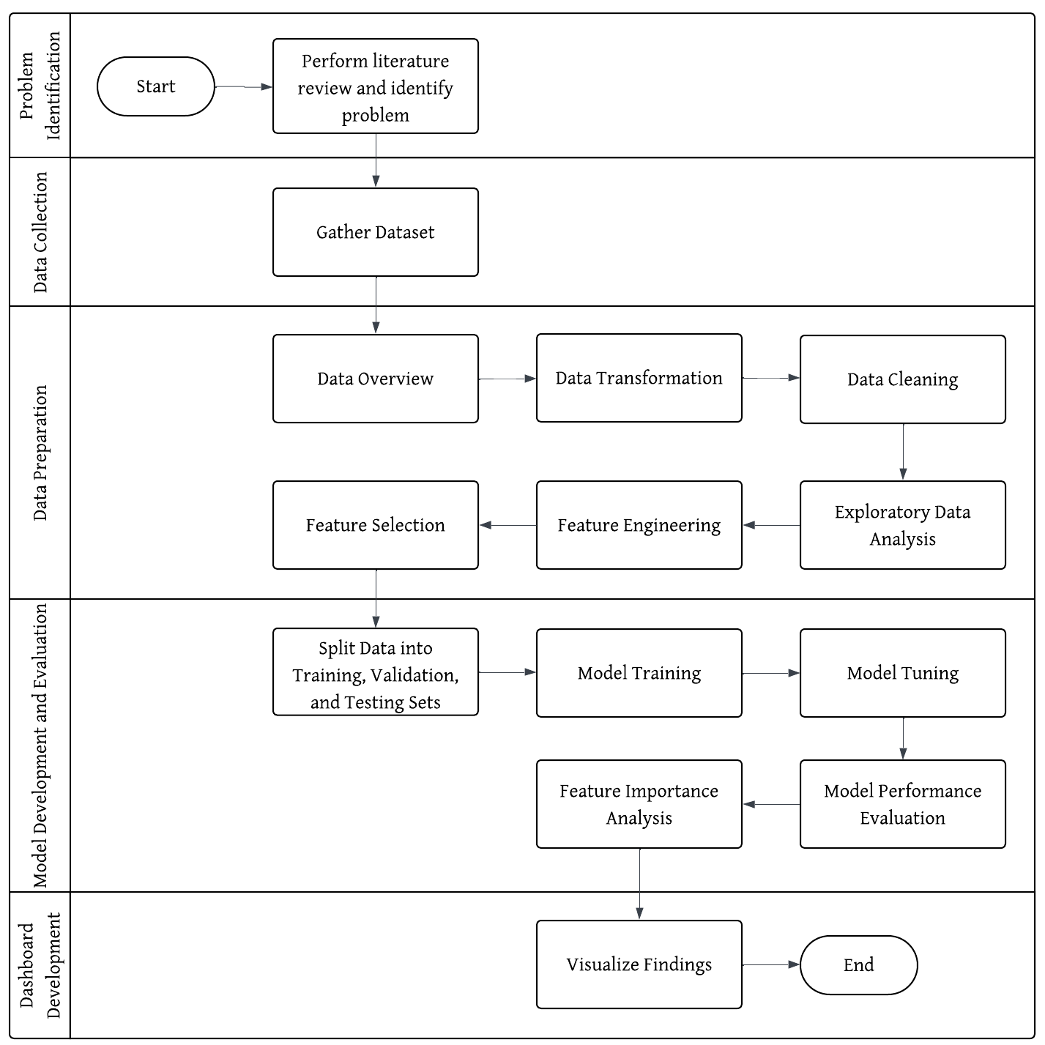
PROJECT LIFECYCLE
1
PROBLEM IDENTIFICATION
Understand the current challenges in money laundering detection through literature review
2
DATA COLLECTION
Obtain dataset for model development
DATA PREPARATION
Data Overview : No. of attributes, data types, categories for each features
Data Transformation: Convert data type for certain columns (e.g: integer → string) or derive new features from existing feature (e.g: ‘Day_of_week’ and ‘Is_weekend’ are derived from ‘Date’ column)
Data Cleaning: Check for missing and duplicate data and remove irrelevant columns
Exploratory Data Analysis (EDA) : identify the patterns, and trends in the dataset
Feature Engineering: Label Encoding
Feature Selection: Correlation Analysis
3
4
MODEL DEVELOPMENT AND EVALUATION
Split Train-Test: 70% Training, 15% Validating, 15% Testing
Train using Random Forest and XGBoost
Tune hyperparameter and adjust threshold to improve the model
Evaluate model using precision, recall, F1-score and accuracy
Perform feature importance analysis
5
DASHBOARD DEVELOPMENT
- Visualize findings using interactive dashboards

Slide 14
CHAPTER 4
DATA PREPARATION

Slide 15

DATASET
Size | 9,504,851 rows
Attributes | 12 Attributes Time Date Sender_account Receiver_account Amount Payment_currency | Received_currency Sender_bank_location Receiver_bank_location Payment_type Is_laundering Laundering_type
DATASET
Synthetic transaction dataset called SAML-D
Produced by research paper entitled ‘Enhancing Anti-Money Laundering: Development of a Synthetic Transaction Monitoring Dataset’ by Berkan Oztas et al. in 2023
Publicly available in Kaggle
DATA TRANSFORMATION
DERIVED NEW FEATURES
1. DateTime | Combine Date and Time to obtain timestamp of the transaction to derive new features related to time.
1. TimeOfDay | Indicates whether it is ‘Day’ (6AM to 6PM) or ‘Night’ 6PM to 6 AM.
2. Is_Weekend | Assign ‘1’ if weekend, ‘0’ if weekday.
3. Tx_per_Day | Daily transaction frequency per sender.
4. Tx_Interval | Transactions interval from previous transactions grouped by sender (in sec).
5. Avg_Amount_Sent | Average transaction amount per sender.
6. Pair_bank_location | Combine Sender Bank Location and Receiver Bank Location.
7. Pair_currency | Combine Payment Currency and Received Currency.

Slide 16
DATA TRANSFORMATION
CATEGORICAL SIMPLIFICATION
‘Laundering_Structure’ (New Feature) | ‘Laundering_type’ (Original Feature)
1. Cash_Deposit | Normal_Cash_Deposits
2. Fan-Out | Normal_Fan_Out, Normal_Small_Fan_Out, Layered_Fan_Out, Fan_Out
3. Fan-In | Normal_Fan_In, Layered_Fan_In, Fan_In
4. Cash_Withdrawal | Normal_Cash_Withdrawal, Cash_Withdrawal
5. Behavioral_Group | Normal_Group, Behavioural_Change_1, Behavioural_Change_2
6. Mutual | Normal_Mutual, Normal_Plus_Mutual
7. Forward | Normal_Foward, Deposit-Send
8. Periodical | Normal_Periodical
9. Structuring | Smurfing, Structuring
10. Cycle | Cycle
11. Bipartite | Stacked Bipartite, Bipartite
12. Scatter-Gather | Scatter-Gather
13. Gather-Scatter | Gather-Scatter
14. Single_Large | Normal_single_large, Single_large
15. Over-Invoicing | Over-Invoicing

Slide 17


DATA CLEANING
FEATURE ENGINEERING
Missing and Duplicated Data
No duplicated data but has 292,715 missing values in column Tx_Interval
Because it is the first transaction for the account, hence it has no previous transaction to compute the interval.
Therefore, missing values are imputed with ‘0’
Label Encoding: Transform categorical variables into numerical variables
Payment_type
TimeOfDay
Pair_bank_location
Pair_currency
Laundering_Structure
Example:
Remove Irrelevant Columns
Sender_account
Receiver_account
Date
Time
DateTime
Payment_currency
Received_currency
Sender_bank_location
Receiver_bank_location
Laundering_type
Pair Bank Location
UK - UK
UK – Morocco
UK - Nigeria
UK - Albania
UK -Mexico
Pair Bank Location
304
296
298
288
295
Because it have been used to derive new features. The info already captured in derived features.
Even though it is not ordinal data, label encoding is selected due to its high cardinality (324 total pairs)

Slide 18
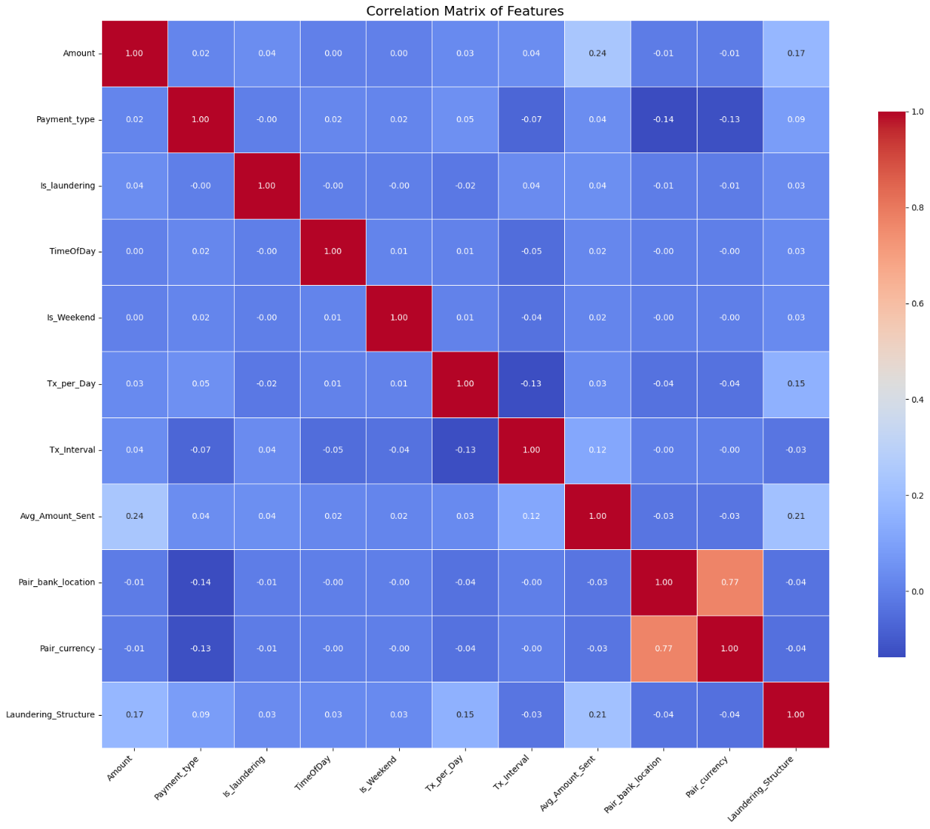

FEATURE SELECTION
Correlation with target (Is_laundering)
1. Avg_Amount_Sent | 0.0431
2. Amount | 0.0401
3. Tx_Interval | 0.0360
4. Laundering_Structure | 0.0321
5. Tx_per_Day | -0.0188
6. Pair_currency | -0.0105
7. Pair_bank_location | -0.0065
8. Payment_type | -0.0017
9. TimeOfDay | -0.0015
10. Is_Weekend | -0.0011
All features have very weak linear correlations with target feature (<0.05)
Multicollinearity exist between Pair bank location and Pair currency (>0.75)
Remain all features except for Pair_currency due to multicollinearity.
Therefore, the model is now has 9 independent variables (x) and 1 dependent variable ready for training.
The dependent/target variable:
Is_laundering where ‘0’ is normal transaction and ‘1’ suspicious transaction

Slide 19
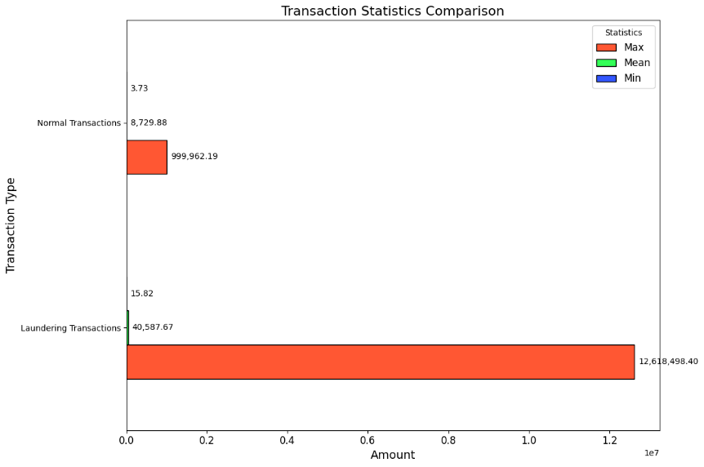
EXPLORATORY DATA ANALYSIS
1
Identify Min, Max & Mean for Laundering and Normal Transactions
Maximum amount in laundering transactions is significantly higher than normal transactions
Both transactions have extremely small minimum amount
Laundering transactions often involve extreme values
Large Gaps = Extreme Outliers

Slide 20
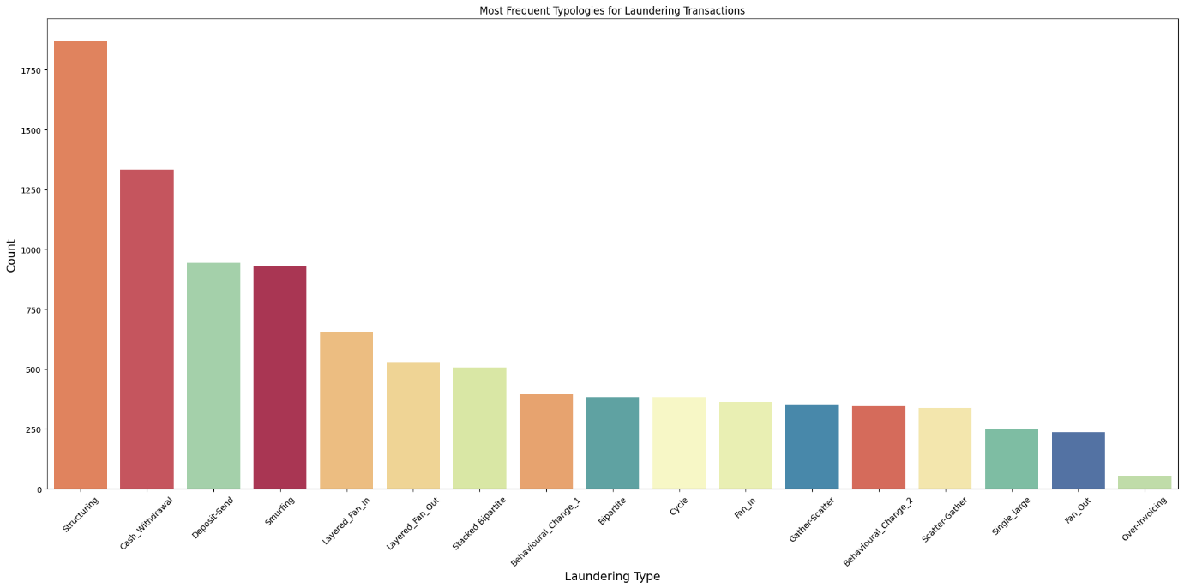
EXPLORATORY DATA ANALYSIS
2
Identify Most Frequent Typologies for Laundering Transactions
Structuring, Cash Withdrawal, Deposit Send & Smurfing are the most dominant typologies

Slide 21
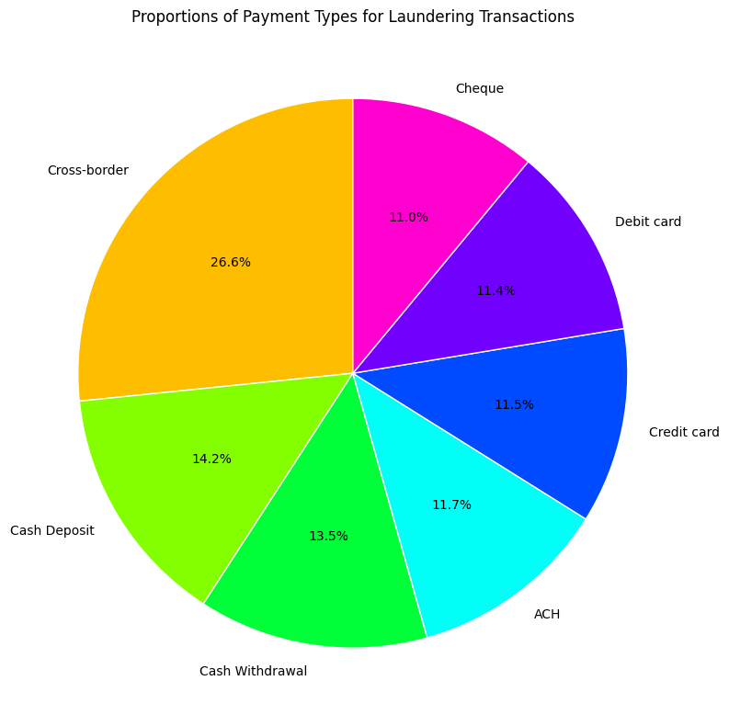
EXPLORATORY DATA ANALYSIS
3
Identify Most Frequent Payment Types for Laundering Transactions
Cross-border transactions has the largest proportions followed by Cash Deposit and Cash Withdrawal
ACH, Credit Card, Debit Card, and Cheque have relatively similar proportion
Cross-border transactions is the most preferred payment method by launderers

Slide 22
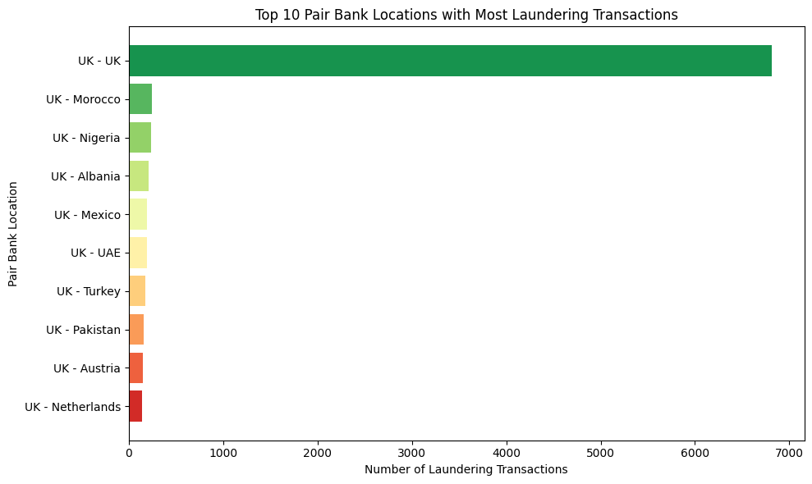
EXPLORATORY DATA ANALYSIS
4
Identify High Risk Pair Bank Locations
UK is the most high-risk pair bank locations as it seems to be a central hub for both sending and receiving illicit money from laundering transactions

Slide 23
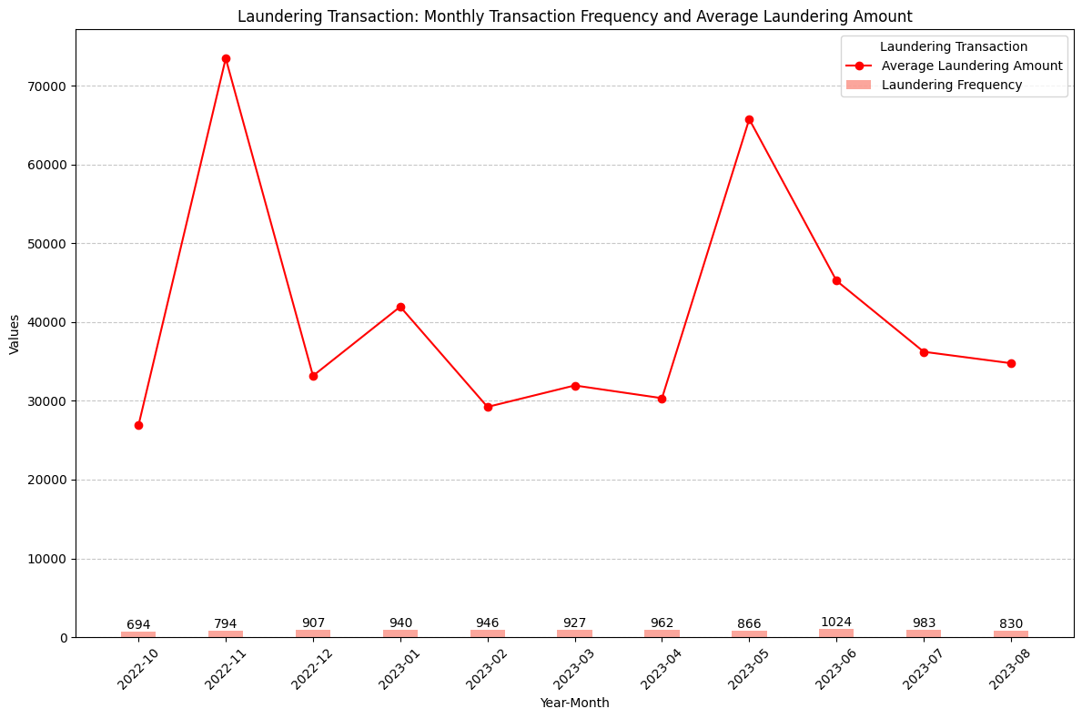
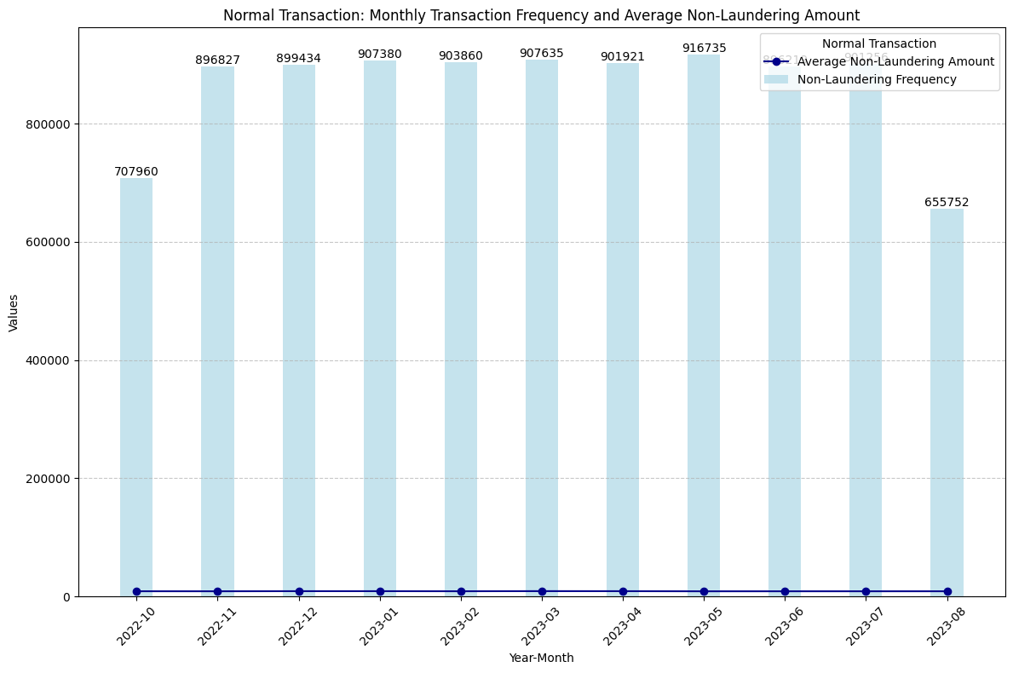
EXPLORATORY DATA ANALYSIS
5
Identify Monthly Transaction Frequency and Average Laundering Amount by Transaction Type
The sharp contrast in frequency and amount emphasize that laundering transactions occurrence are rare but usually involve larger amounts of money.

Slide 24
CHAPTER 5
MODEL DEVELOPMENT AND EVALUATION

Slide 25
SPLIT TRAIN-VALIDATE-TEST DATASET USING STRATIFIED SAMPLING
Ratio :
70 : 15 : 15
Sampling method:
Stratified sampling was selected as sampling method throughout this project ensuring the class proportions are preserved across training, validation, and testing set.
Training Set | Validation Set | Testing Set
6,657,198 records | 1,421,926 records | 1,425,728 records
 |  | Precision | Recall | F1-Score | Accuracy
Random Forest | Random Sampling | 0.9829 | 0.7033 | 0.8199 | 0.9997
 | Stratified Sampling | 0.9894 | 0.6919 | 0.8143 | 0.9997
XGBoost | Random Sampling | 0.8412 | 0.6327 | 0.7222 | 0.9995
 | Stratified Sampling | 0.8923 | 0.6845 | 0.7747 | 0.9996
Default Parameters:
Random Forest | XGBoost
n_estimators =100 max_depth = None min_samples_split = 2 random_state = 42 n_jobs = -1 | n_estimators = 100 max_depth = 6 learning_rate = 0.3 subsample = 1 random_state = 42 n_jobs=-1
Random Forest:
Minor difference between strategies.
Show stable performance regardless of different strategies.
XGBoost:
Stronger dependence on sampling strategy.
More balanced performance using stratified sampling.
Therefore, the result from stratified sampling with default setting become the baseline model to compare throughout the project.
Notes:
This ratio provides a good balance between model learning and evaluation.
With 70% of the data, the model has enough information to learn patterns effectively. At the same time, the 30% test set is large enough to give reliable and unbiased evaluation results.
This split is widely accepted in machine learning, especially when working with medium to large datasets. It helps reduce the risk of overfitting while still ensuring the model is tested on unseen data.

Slide 26
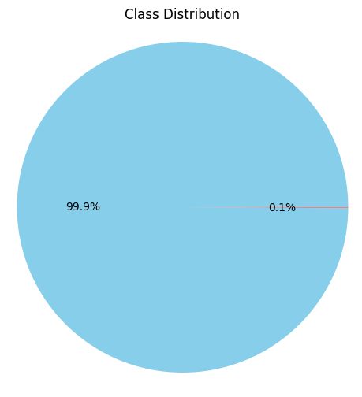
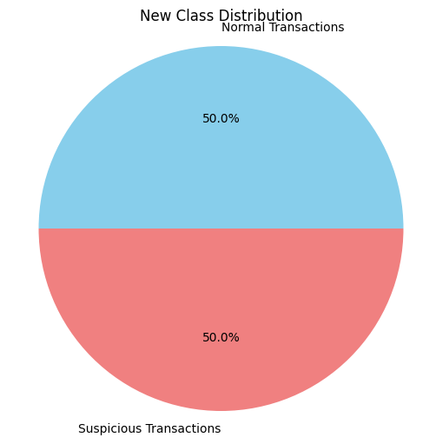

HANDLING CLASS IMBALANCE (during model training only)
Random Under Sampling
Result Comparison:
Reducing the majority samples (normal transactions) to match the size of minority class (laundering transactions).
 |  | Precision | Recall | F1-Score | Accuracy
Random Forest | Baseline | 0.9894 | 0.6919 | 0.8143 | 0.9997
 | With RUS | 0.0214 | 0.9479 | 0.0419 | 0.9550
 | With Class Weight | 0.9929 | 0.6669 | 0.7979 | 0.9996
XGBoost | Baseline | 0.8923 | 0.6845 | 0.7747 | 0.9996
 | With RUS | 0.0234 | 0.9553 | 0.0456 | 0.9585
 | With Class Weight | 0.0648 | 0.9242 | 0.1211 | 0.9861
 | Tranining Set before RUS | Training Set after RUS
Normal Transactions | 6,650,283 | 6,915
Suspicious Transactions | 6,915 | 6,915
Class Weighting
Assign higher weight to minority class so that the model penalizes more severely on the misclassification of suspicious transactions
Random Under Sampling:
Degraded both model performance (based on F1-score)
Recall increase from 0.6 to 0.9, but precision drop significantly
Class Weighting:
XGBoost: Very high recall, very low precision. (Drastic effect)
Random Forest:. Maintain high precision, with slightly decline in recall. Still less balance than baseline.
Random Forest | XGBoost
Parameter: class_weight = ‘balanced’ Automatically compute class weight: Normal = 0.50 Suspicious = 481.43 Suspicious transactions were treated 481 times more important than normal transactions during splitting in tree construction | Parameter: scale_pos_weight Value computed using formula: Total Majority / Total Minority = 961.71 Suspicious transactions are 962 times rarer than normal transactions.
Therefore, these imbalanced handling methods will not be applied in the next stage as the result is not satisfactory.
Notes:
During model training only to keep the validation and testing set with original class distribution so that the evaluation reflected real-world scenarios.
But still not better than baseline
Study about class weight, different between RF and XGB
Minimize false positives and catch as much true suspicious transactions as possible

Slide 27
2-STAGE MODEL OPTIMIZATION
Tune Hyperparameter using Randomized SearchCV
Adjust Threshold
Control how the model learn form the data and to balance overfitting and underfitting.
To reduce computational cost:
  Use subsample of 200k from training dataset with stratified sampling. Then, refitted on the full training dataset once the best hyperparameters are identified.
  Use Randomized Search with 3-fold CV. Randomly select a subset of hyperparameter combination from the parameter grid.
Best hyperparameters:
Result after Tuning:
By default, classifiers algorithm use threshold = 0.5 on the predicted probability to decide the class.
Evaluate different probability threshold between 0.1 to 0.9 to select the best threshold that maximize F1-score.
Best Threshold:
Random Forest = 0.24
XGBoost = 0.28
Result after Tuning & Adjust Threshold:
Random Forest | XGBoost
n_estimators =100 max_depth = None min_samples_split = 2 | n_estimators = 100 max_depth = 6 learning_rate = 0.1 subsample = 1
 | Precision | Recall | F1-Score | Accuracy
Random Forest | 0.9185 | 0.7630 | 0.8336 | 0.9997
XGBoost | 0.9236 | 0.7041 | 0.7991 | 0.9996
 | Precision | Recall | F1-Score | Accuracy
Random Forest | 0.9894 | 0.6919 | 0.8143 | 0.9997
XGBoost | 0.9614 | 0.6750 | 0.7932 | 0.9996
Adjusting threshold below 0.5 makes the model classify more true suspicious case, hence the increase in recall. Even the precision have slightly dropped, it still above 0.90. Hence, the F1-Score improved for both model.
Threshold tuning also proven to handle imbalanced dataset. High accuracy in this model is due to dominance of majority class. Hence, adjusting threshold allowed the models to make better trade-offs between detecting suspicious transactions and minimizing false positives
Same result as baseline.
Default parameter = Best parameter
Result improved than baseline
Random Forest achieved slightly better F1-score, fewer false positives and fewer misclassifications
Notes:
Compared to GridSearchCV which exhaustively test all possible hyperparameters combination
But this default threshold often favors majority class in highly imbalance dataset which leads to low recall for the minority class.

Slide 28



FINAL EVALUATION
Retrained models on the combined Training+Validation Set using Best Hyperparameters
Predict the Testing Set using
Best Probability Threshold
Random Forest
Final Result:
XGBoost
 | Precision | Recall | F1-Score | Accuracy
Training Set | 0.9978 | 1.0000 | 0.9989 | 1.0000
Validation Set | 0.9185 | 0.7630 | 0.8336 | 0.9997
Testing Set | 0.9113 | 0.7698 | 0.8346 | 0.9997
 | Precision | Recall | F1-Score | Accuracy
Training Set | 0.9340 | 0.7138 | 0.8092 | 0.9997
Validation Set | 0.9236 | 0.7041 | 0.7991 | 0.9996
Testing Set | 0.9261 | 0.6935 | 0.7931 | 0.9996
Nearly perfect performance in Training Set.
Slightly lower performance in Validation & Testing Set.
  Not much difference in the performance.
  Precision > 0.91, Recall > 0.76, F1-Score > 0.83
  Effective in minimizing false alarms but less effective in capturing all suspicious transactions.
Consistent and reliable result in validation and testing prove that the model can generalize well
The model produced consistent result with minor variations throughout training until testing. Maintaining:
  Precision (0.92-0.93), Recall (0.69-0.71),F1-Score (0.79-0.80)
Performs well in reducing false alarms but a bit struggle to capture all true suspicious (High Precision Low Recall)
Model generalizes well and not overfitting.
Random Forest outperform XGBoost in terms of recall and F1 Score across validation and testing set. Hence, it becomes the preferred model since it offers overall effectiveness in detecting money laundering transactions
Notes:
Compared to GridSearchCV which exhaustively test all possible hyperparameters combination
But this default threshold often favors majority class in highly imbalance dataset which leads to low recall for the minority class.

Slide 29
FEATURE IMPORTANCE ANALYSIS BASED ON RANDOM FOREST
Feature Importance
Represents the contributions of each feature to the model‘s predictions.
In Random Forest, it is calculated based on how much each feature decreases the Gini impurity across all decision trees.
Features that consistently create better split have higher importance score.
Feature | Importance Score
1. Laundering_Structure | 0.4666
2. Amount | 0.1413
3. Avg_Amount_Sent | 0.1386
4. Tx_Interval | 0.1143
5. Payment_type | 0.0710
6. Pair_bank_location | 0.0291
7. Tx_per_Day | 0.0253
8. Is_Weekend | 0.0079
9. TimeOfDay | 0.0059
Most Influential Features
Random Forest is most sensitive to structural and monetary characteristics of transactions while temporal features have lesser contribution to the overall prediction.
It corresponds with expectation in money laundering where structuring and manipulation of transaction value are key red flags
Least Influential Features
Notes:
Compared to GridSearchCV which exhaustively test all possible hyperparameters combination
But this default threshold often favors majority class in highly imbalance dataset which leads to low recall for the minority class.

Slide 30
CHAPTER 6
DASHBOARD DEVELOPMENT

Slide 31
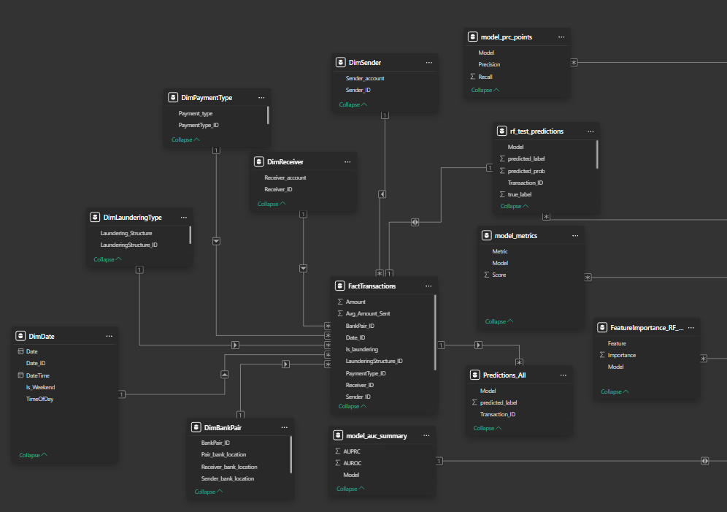

DATA PREPARATION FOR DASHBOARD
Include Transcation ID
Primary key for linking different tables
Separate the dataset into Fact Tables, Dimension Tables, and Result Tables
Fact Table: contain IDs and transactional details (Amount, Transaction_ID)
Dimension Tables: contain descriptive information (Location, Payment_type)
Result Tables: stores predicted labels and metrics
To improve query efficiency and makes the dashboard easier to maintain and navigate
Construct Star Schema
Fact tables at the centre connecting with dimension tables and certain result tables through foreign key.
Enables aggregation, filtering, and slicing data to be done efficiently when developing dashboard.

Slide 32
CHAPTER 7
CONCLUSION

Slide 33



SUMMARY
LIMITATION
FUTURE WORK
Achieved Objective 1 – Completed data preprocessing and EDA
Cleaned, transformed, and derived new features
Explore transaction patterns such as most preferred payment types and high-risk pair countries
Synthetic data may not fully capture the complexity of real-world financial transactions.
Collaborate with financial institutions to apply methodology on real dataset.
Achieved Objective 2 – Built and evaluated classification models
Developed Random Forest & XGBoost, then tuned and tested
Result shows that Random Forest performed slightly better
Expand the models approach to deep learning, graph-based, and hybrid.
Only Random Forest and XGBoost are tested (no deep learning or graph-based method).
Achieved Objective 3 – Developed interactive dashboard
Built dashboard using PowerBI with fact, dimension, and result tables
Visualize insights based on descriptive, diagnostic, predictive, and prescriptive analytics
Models still has limited interpretability. Feature importance offers limited transparency to compliance officers.
Use SHAP to enhance explainability for transparency and regulatory trust.

Slide 34
THANK YOU

